Slide 1
R.I.P. Overused Dead Words

Slide 2
It’s creepy how sometimes words come back from the dead and are used over and over again in your writing!
It is time to lay these overused words to rest!

Slide 3
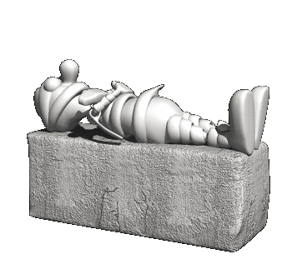
Here lies the word SCARED
More lively words
frightened
petrified
terrified
afraid
fearful

Slide 4
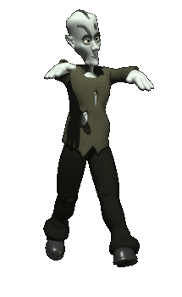
Here lies the word ALSO
More lively words
moreover
besides
as well as
in addition to

Slide 5
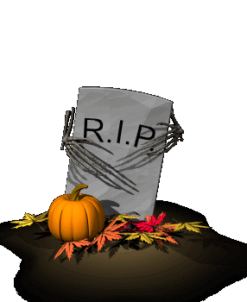
Here lies the word AWESOME
More lively words
amazing
wonderful
stupendous
phenomenal
marvelous

Slide 6
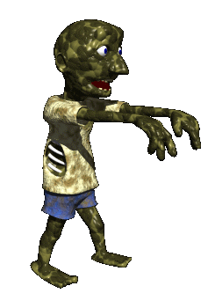
Here lies the word LOTS
More lively words
numerous
heaps
many
plentiful
oodles

Slide 7
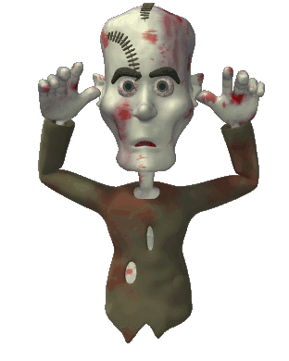
Here lies the word NICE
More lively words
pleasant
charming
captivating
delightful
pleasing

Slide 8
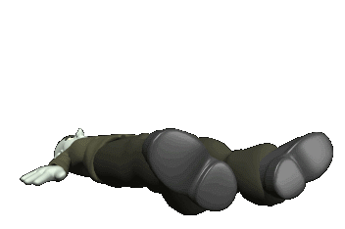
Here lies the word FUNNY
More lively words
amusing
comical
laughable
jovial
humorous

Slide 9
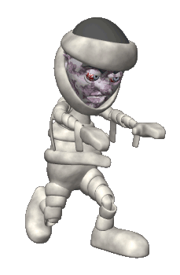
Here lies the word GOOD
Then: first, second, next, later, finally, afterward, meanwhile, soon
More lively words
exceptional
marvelous
extraordinary
splendid
superb

Slide 10
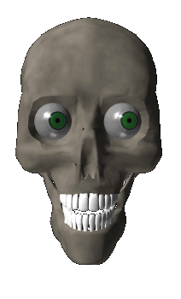
Here lies the word VERY
More lively words
incredibly
extremely
especially
unusually
shockingly

Slide 11
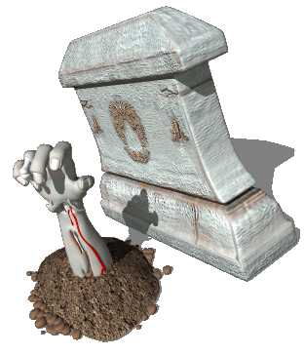
Here lies the word THEN
Then: first, second, next, later, finally, afterward, meanwhile, soon
More lively words
first
next
finally
afterward
meanwhile

Slide 12
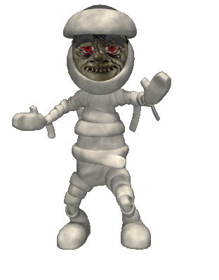
Here lies the word MAD
Then: first, second, next, later, finally, afterward, meanwhile, soon
More lively words
angry
frustrated
furious
incensed
enraged

Slide 13
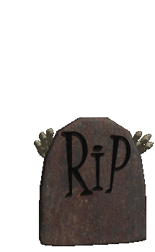
Here lies the word BUT
Then: first, second, next, later, finally, afterward, meanwhile, soon
More lively words
however
moreover
on the other hand
though
yet
still

Slide 14
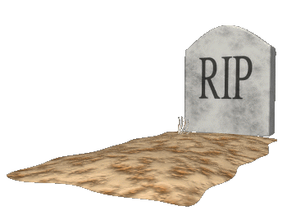
Here lies the word AWFUL
Then: first, second, next, later, finally, afterward, meanwhile, soon
More lively words
dreadful
alarming
terrible
horrible
shocking

Slide 15
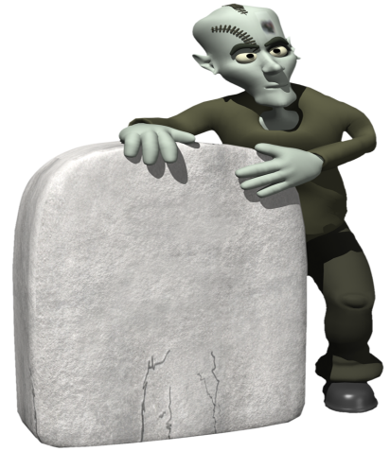
R.I.P. Overused Words Questions

Slide 16
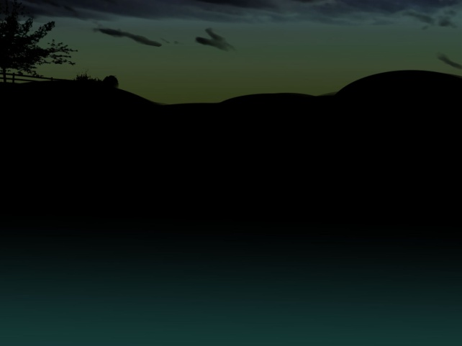
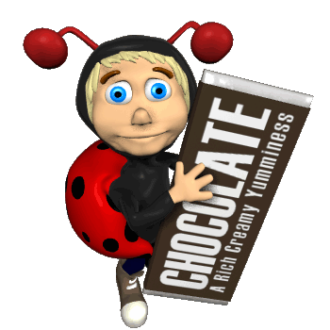
The candy corn was on the top of the candy list, but chocolate bars won the candy survey.
What was the overused word in the sentence?
Top
Candy
But
Won

Slide 17
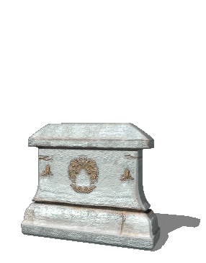
Oops!
Grave Mistake!
Try Again

Slide 18
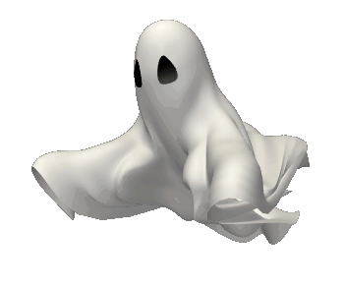
Spook-tacular Work!

Slide 19
BUT is the overused word
Try replacing the word…
however
moreover
on the other hand
though
yet
still
The candy corn was on the top of the candy list, however chocolate bars won the candy survey.

Slide 20
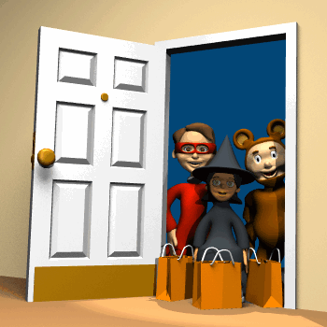
The excited trick-or-treaters got lots of candy on Halloween.
What was the overused word in the sentence?
lots
excited
got
candy

Slide 21
Oops!
Grave Mistake!
Try Again

Slide 22
Spook-tacular Work!

Slide 23
LOTS is the overused word
Try replacing the word…
numerous
heaps
many
plentiful
oodles
The excited trick-or-treaters got heaps of candy on Halloween.

Slide 24
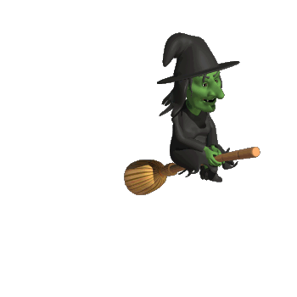
The very wicked witch flew through the spooky night sky.
What was the overused word in the sentence?
through
sky
flew
very

Slide 25
Oops!
Grave Mistake!
Try Again

Slide 26
Spook-tacular Work!

Slide 27
VERY is the overused word
Try replacing the word…
incredibly
extremely
especially
unusually
shockingly
The shockingly wicked witch flew through the spooky night sky.

Slide 28
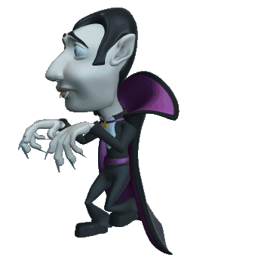
Dracula went creeping through the street, then he found his dinner!
What was the overused word in the sentence?
through
went
then
his

Slide 29
Oops!
Grave Mistake!
Try Again

Slide 30
Spook-tacular Work!

Slide 31
THEN is the overused word
Try replacing the word…
first
next
finally
afterward
meanwhile
soon
Dracula went creeping through the street, finally he found his dinner!

Slide 32
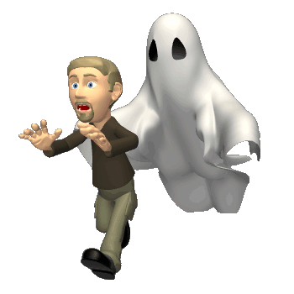
The white ghost is chasing the scared man.
What was the overused word in the sentence?
ghost
scared
man
white

Slide 33
Oops!
Grave Mistake!
Try Again

Slide 34
Spook-tacular Work!

Slide 35
SCARED is the overused word
Try replacing the word…
frightened
petrified
terrified
afraid
fearful
The white ghost is chasing the petrified man.

Slide 36
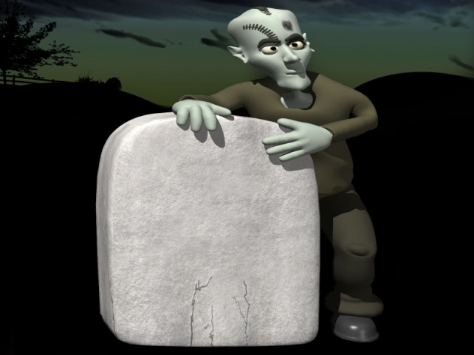
walk
said
mad
got
fun
cool
small
kid
sad
big
happy
saw
great
ran
Other words that should be laid to rest
awful
pretty
like
really
so
stuff
laugh
thing
go
smart

Slide 37
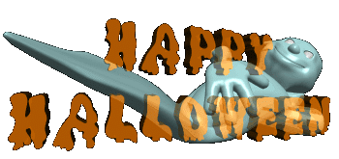
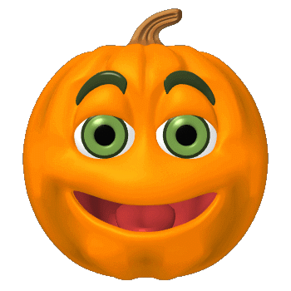
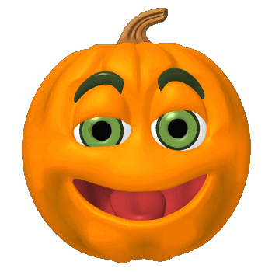
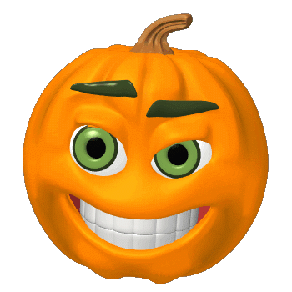
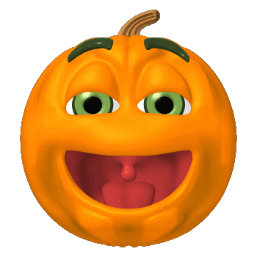
Create a class “Dead Word”
cemetery using the
overused words in this
powerpoint.

