Slide 1
Theme

Slide 2
Definition
In your group, define what you think is the definition of theme.

Slide 3
Why is theme important?
The theme is a literary work’s primary purpose

Slide 4
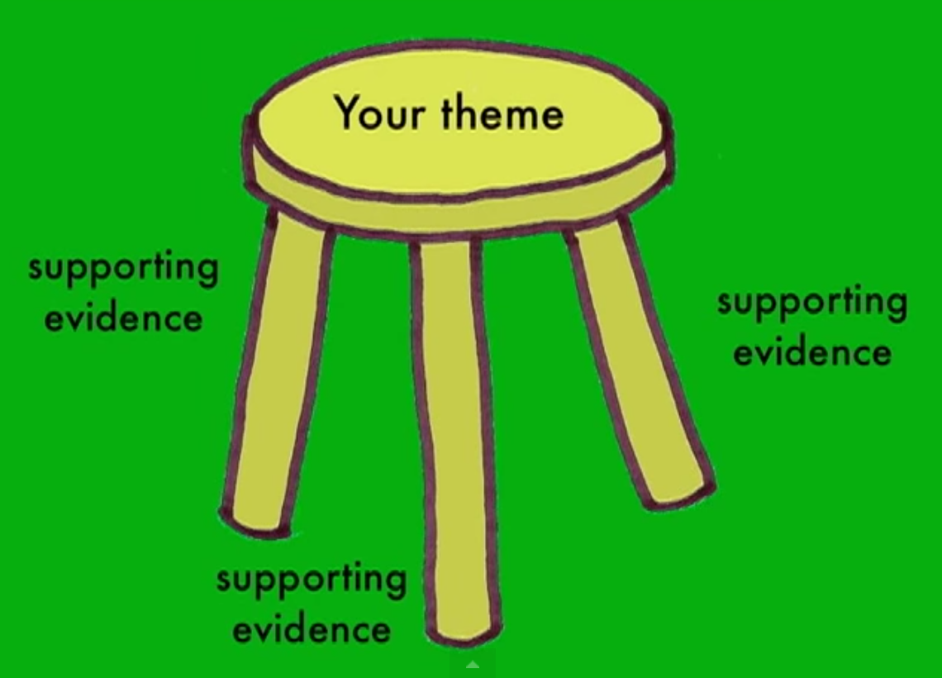
Good Works of Literature
A good work of literature is complex and could contain many themes, Much like how a story can have multiple conflicts.
Some may be large and obvious; some may be small and less obvious.

Slide 5
The reader owns the meaning
Much like when you read, you find ideas in the story that the author may have never intended. But for you, it’s there, and it has meaning.
Keep this in mind for your audience.

Slide 6
Overview
Notes:
The times correspond with the following video: https://www.youtube.com/watch?v=p4qME64SkxM

Slide 7
Multiple themes exist in any piece of art. Art is nuanced, so any painting, story, photograph, play, sculpture, or song will have multiple lessons within.
A theme is never one word. There’s a difference between topics and themes. Family, love, and betrayal are all topics. The specific comment the author wants to make about families is the theme.

Slide 8
Read The Red Tree
Pay attention the the following story The Red Tree by Shaun Tan
Have some fun; count how many red leaves you see.
More importantly, pay attention to theme throughout the story.
Notes:
https://www.youtube.com/watch?v=PrmMFFpKxgw

Slide 9
STEP ONE: This book is about…
ON your OWN: Complete this phrase, “The book is about….”
Challenge yourself to create at least 30 words or phrases in two to five minutes.
Get it down. Don’t edit. Just write.
Then, Review the difference between abstract and concrete words. In this process, concrete words will not lead to theme statements, so we will these out.
Notes:
I ask the students to choose three words from their lists that bring about strong reactions. I say, “If I ask you to write an essay about this book (I won’t) or talk to a friend for fifteen minutes…which of these words sparks the most ideas in your head?” After selecting three words, I ask them to choose the best one.
Use this worksheet https://docs.google.com/a/bbchs.org/file/d/0B13ar51JaojaOGY4OGViZWUtNWUxNC00YTA5LTk1M2EtNTk3MGIwMDkwZTYy/edit?hl=en#

Slide 10
STEP TWO: The author feels that …
Take the best word from step one and plug it into the phrase, “The author feels that ______________…..”
Write at least three theme statements with that one topic, trying to write something new each time. Don’t write the same idea with different words.
I will be walking around to check your examples.
Notes:
This step requires plentiful and frequent feedback. I roam the room and check in with each student several times, pointing out errors and helping them push past their first thoughts to their best thoughts.

Slide 11
STEP TWO Examples
The author feels that imagination can help any individual overcome the dire, unchanging, and harsh realities of life.
2. The author feels that imagination transforms a person, making him stronger and more hopeful than before.
3. The author feels that imagination helps the little girl return to her room with enough hope to face the next day.
4. The author feels that imagination lives in every individual as an invincible force, a small thing that can withstand life’s greatest
5. The author feels that imagination, though often ignored or unnoticed, lives in everyone and is the small thing that defines us as unique individuals.

Slide 12
STEP THREE: Polish
Now that you have written 3-5 theme statements choose the best one.
Next, we cut “The author feels that….” phrase.
Be concise (PACT), such phrases are filler.
Finally, I encourage you to write your ideas as precisely and stylishly as you can.
Where am I adding style? In my examples?
In the book, a red tree sprouts in the closing pages, and I am conjuring this image with my diction. I use style to illustrate the growth of the tree, to really focus on imagery of the story I’m trying to parallel.
Notes:
I use my example theme statements for The Red Tree to model this selection process. (Note: #3 is NOT a theme.)

Slide 13
Of course, this one lesson will not teach all of you how to write a brilliant theme statement or a brilliant theme.
It does, however, lay an excellent foundation, and through frequent practice you will master this skill and hopefully be able to create your own theme for your narrative story.

Slide 14
How to develop your theme
Look at your main character.
Consider what will happen to them
Will he or she change in some way?
Sometimes authors like to state the theme
Such as in a conclusion at the end of the book by a character and his/her observations
A title can give clues to the theme
Examine your conflict; how could this portray theme?

